Slide 1

Javascript tools and workflow
ZVONIMIR BUŠIĆ

Slide 2

Tools used in modern Javascript development
workflow
Source control tool - git
Package manager - npm, yarn
Code transpiler - babel, typescript
Task runners and code bundlers - grunt, webpack

Slide 3

Source control: git
source control gives ability to save and manage changes of your code over time
it enables creation of alternate copies of work (branches) on which you can work without affection other branches
it allows to check any previous state of working tree on any branch

Slide 4
git: commands
git init - initialize git repository
- git init directory-name - initialize git repository in sub directory
git add - staged files for commit
git add . - stage all changed files
git add file-name - stage one file
git commit - commit added files

Slide 5
Zadatak
Initialize repository “js-tools-and-workflow”

Slide 6

Package manger: npm
npm is package (module) manager
packages can contain code that can be used in your projects or command line tools
it allows installation of packages locally in project or globally
it has its own package registry registry.npmjs.org from which packages can be installed

Slide 7
npm - commands
npm init - creates new package.json
npm install - installs new package to project or install all project packages
--save
--save-dev
npm update - updates packages to newer version respecting npm semver
npm run - runs on of the scripts from scripts field in package.json
npm start - runs “start” script from package.json
Notes:
npm install - when installing new package it defaults to carret range
npm install - objasniti kako se instalira odredjena verzija paketa

Slide 8
Zadatak
Initialize new package.json in “js-tools-and-workflow” folder
add it and commit it with git
Notes:
npm install - when installing new package it defaults to carret range

Slide 9

Code transpiler: babel
babel enables conversion of ES2015+ code into code compatible with our desired runtime environment
babel uses modular presets and plugins that are installed separately as needed

Slide 10
babel - installation to project
install it using npm
npm i @babel/cli @babel/core
@babel/cli - cli tool that can be used for direct transpilation of code but more often @babel/core is used as part of some another build tool
@babel/cli usage
babel `source file or directory` -d `destination file or directory`
install desired preset
- in our case it will be @babel/preset-env which will enable traspilation of code for desired environment

Slide 11
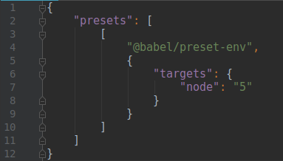
Example
install @babel/cli @babel/core @babel/preset-env as dev dependencies
create .babelrc file
add @babel/preset-env as presets with node target

Slide 12

Example
create index.js file
run babel index.js -d dist
check code in dist/index.js file

Slide 13
Code bundler: webpack
webpack is module bundler for modern backend and frontend javascript applications
it doesn’t require configuration file by default but it’s almost always used with configuration file

Slide 14
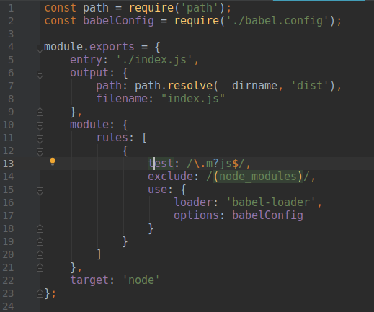
webpack - configuration
basic configuration consists of - entry file/s that will be used for bundling other files
output file/s - bundled files

Slide 15
Example
install webpack and webpack-cli with npm as dev dependency
create webpack config file - webpack.config.js
add “build”: “webpack” script to “package.json”

Slide 16
Any questions?

